Slide 1
Sub-band Audio Coding Using a Two-Band FIR Filter Bank
Vaibhav Khute
Course: Digital Signal Processing

Slide 2
Background and Motivation
Audio signals require large storage and bandwidth
Speech has most energy in low frequencies
Treating all frequencies equally is inefficient
Sub-band coding allows better compression
Notes:
Mobile chat assistants are applications that allow users to interact through text or voice to perform a wide range of tasks based on user queries. These tasks can include:
Cloud-based actions - for example, fetching and displaying weather information.
Core mobile actions - such as making phone calls, sending messages, setting reminders, or creating to-do lists.
Third-party app integrations - interacting with apps like Spotify to play music, Uber to book rides, and many others.
Connected device control - managing external devices including smart home appliances, car media systems, and other IoT devices.

Slide 3
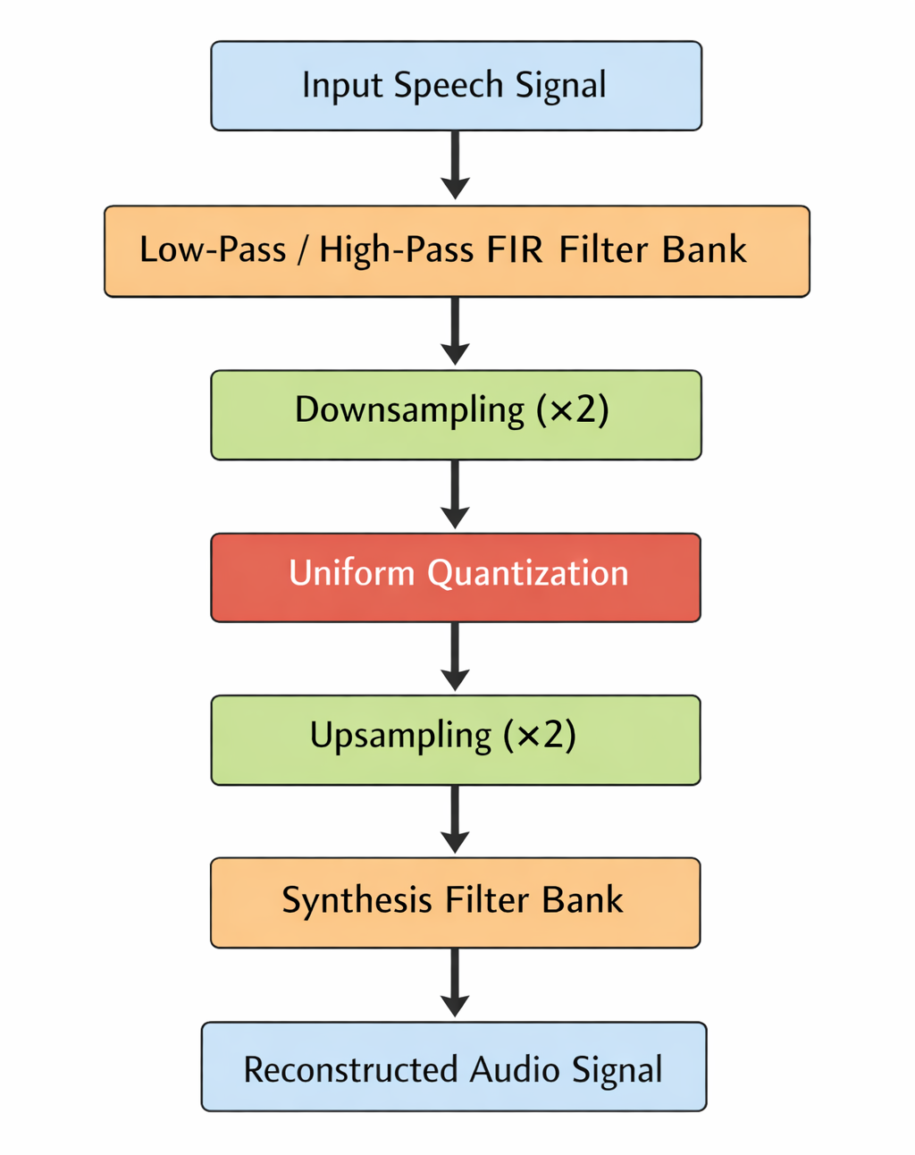
Project Objective
Design a simple sub-band audio coder
Split audio into low and high frequency bands
Compress each band differently
Reconstruct audio and evaluate quality
Notes:
Siri, introduced by Apple, was the first prominent mobile assistant. These early systems were largely rule-based, capable of recognizing specific query patterns and mapping them to a limited set of predefined actions. Following Siri’s introduction, many companies began developing their own mobile assistants integrated into their operating systems and platforms. Google Assistant and Amazon Alexa became two of the most widely adopted examples. More recently, the launch of ChatGPT has ushered in a new generation of AI-driven mobile assistants, capable of handling richer, more open-ended interactions with lot more practical uses.

Slide 4
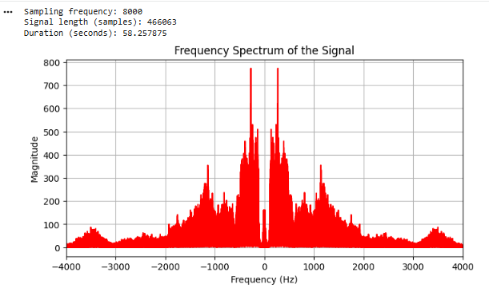
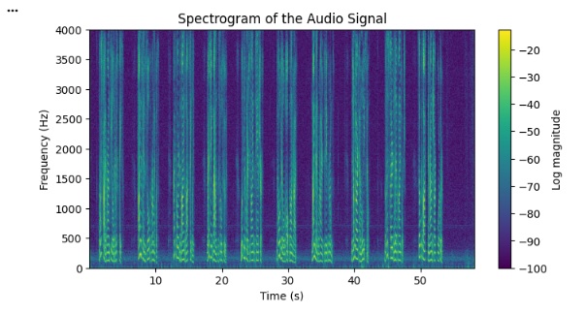
Input Signals
Two speech signals used
Sampling frequency: 8 kHz
Mono speech audio
Open-source speech recordings
Notes:
The idea of chat assistants actually goes back to the 1960s. ELIZA, one of the first chatbots, mimicked a psychotherapist using simple pattern matching. That experiment kicked off decades of research into conversational systems.

Slide 5
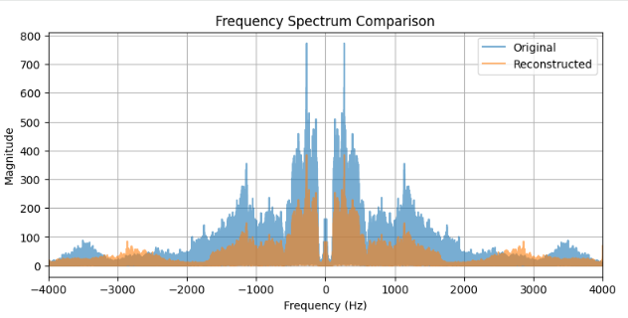


Experiment
Low band: higher bits (8 bits)
High band: lower bits (4 bits)
Measured MSE and SNR
Original
Reconstructed
Notes:
The key innovation in the Siri launch was the voice integration. Users could speak naturally to interact with their device, and Siri’s tight integration with iOS-combined with cloud-based intent parsing-enabled it to interpret user commands and perform a wide range of actions on the iPhone.

Slide 6
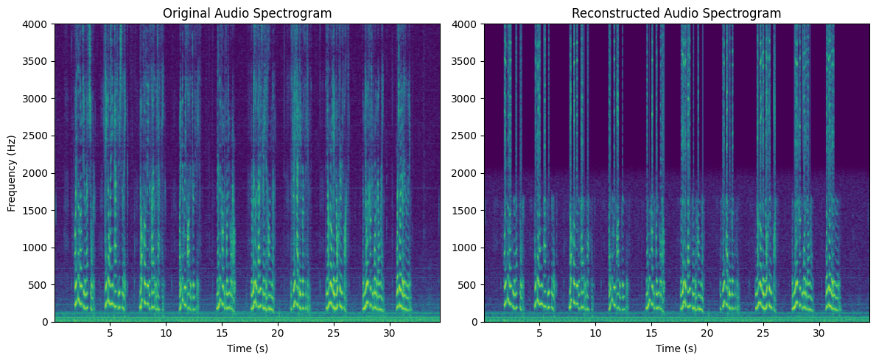
Spectrogram Compression
Notes:
Generally, the internal workings and software architectures of mobile assistant systems are closely guarded secrets. However, a few years ago, Apple shared some insights into the speech recognition infrastructure behind Siri. The system begins with wake-word detection (“Hey Siri”), followed by on-device speech recognition. At the time, Siri’s speech recognition model was a compact system combining Hidden Markov Models (HMMs) with neural network components. The recognized text is then passed to subsequent modules for intent recognition, which determines the user’s request and triggers the appropriate action.

Slide 7
Experiment : Bit Allocation
Different bit allocations were tested with the same bitrate
Reducing low-band bits increases distortion
(4,8) allocation shows the worst performance
Numerical differences in MSE and SNR are small
Perceptual quality depends strongly on bit allocation
Bit Allocation | MSE | SNR (dB) | Interpretation
(6,6) | 0.010069 | −0.60 | Balanced
(8,4) | 0.010104 | −0.62 | Perceptually motivated
(10,2) | 0.010139 | −0.63 | Too aggressive
(4,8) | 0.010180 | −0.65 | Worst case
Notes:
Below is an outline of the Google Assistant data-flow pipeline, reconstructed from publicly available information such as press releases and API documentation. The pipeline highlights the major components and associated technologies. Voice input from the phone’s microphone is first captured using platform-specific media libraries - for example, MediaRecorder on Android or AVAudioEngine on iOS. This audio stream is then transmitted to Google’s cloud servers using a gRPC streaming protocol. In the cloud, a series of machine learning operations are performed, including automatic speech recognition, natural language understanding, and dialogue management. Once the user’s intent is identified, the system triggers the corresponding APIs or actions. The response text is then fed into a text-to-speech engine to generate spoken output. Finally, the synthesized speech audio is streamed back to the mobile device and played using the same media libraries.

Slide 8

Performance Metrics
Original bitrate: 128 kbps
Compressed bitrate: ~48 kbps
Compression ratio: ~2.6
Quality evaluated using MSE and SNR
Notes:
Some of the functionalities offered by different mobile assistants are summarized in the accompanying table. These assistants rely on a variety of system-level APIs - for example, EventKit and CoreLocation on iOS; CalendarProvider and LocationManager on Android; and the App SDK and Smart Home APIs for Alexa. In addition, each platform provides access to core built-in applications such as Mail and Messages on iOS, Gmail and Maps on Android, and Music and Shopping on Alexa-enabled devices. Beyond these, a wide range of third-party applications are supported across assistants, including popular services like Uber, Spotify, and many others.

Slide 9
THANKYOU
Notes:
These emerging capabilities represent some of the most advanced and actively researched features of modern AI systems. By processing video, audio, and other multimodal inputs, AI assistants are beginning to perceive the world in ways that more closely resemble human understanding. This shift may mark the final evolutionary stage of assistants on traditional mobile phones, paving the way for dedicated AI-first form factors such as Meta’s smart glasses and devices like the Rabbit R1.

